Slide 1
CONTROL FLOW

Slide 2
Control Flow
By default C# executes from top to bottom , however we can alter the flow of program execution and provide better control on the flow of execution based on Logic and values.

Slide 3
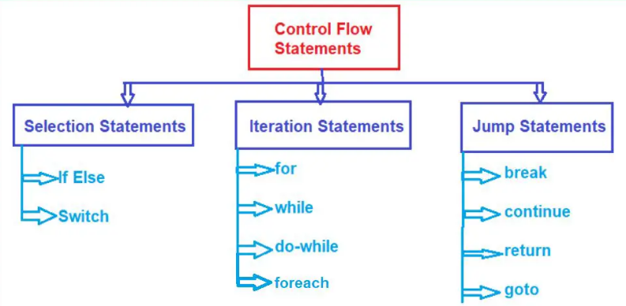

Slide 4
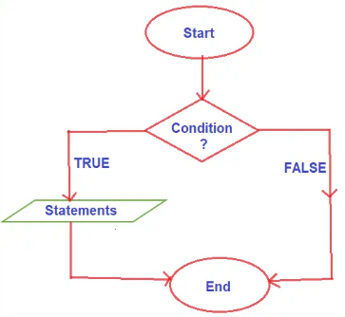
If Statements in C#
If else execute a block of statements (one or more instructions) when the condition in the if block is true and when its false it skip the execution of the if block .

Slide 5
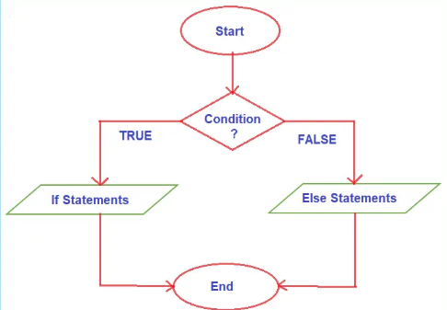
Else If Statement
When the condition is true the if block is executed and if the condition is false then the else block will execute, but only one block is executed.
For every if condition statement, the else block is optional. But for every else block, the if block is compulsory. The purpose of the ‘if’ statement in a program is to allow multiple execution paths for varying user inputs, making it more interactive!

Slide 6
Nested-If and Ladder If
When an if-else statement is present inside the body of another if or else then this is called nested if-else. Nested IF-ELSE statements are used when we want to check for a condition only when the previous dependent condition is true or false.
In Ladder if-else statements one of the statements will be executed depending upon the truth or false of the conditions. As soon as one of the conditions controlling the if is true, the statement associated with that if block is going to be executed, and the rest of the C# else-if ladder is bypassed.

Slide 7
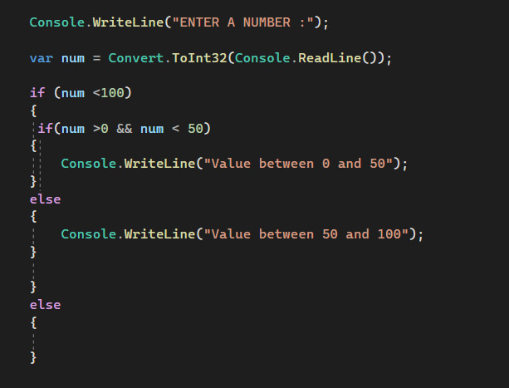
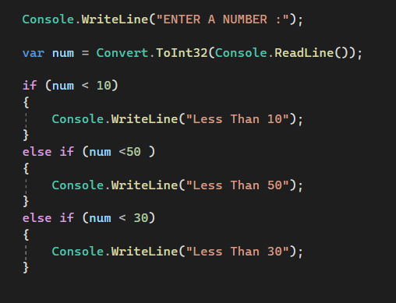

Slide 8
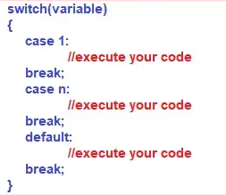
Switch
The switch is a keyword in the C# language, and by using this switch keyword we can create selection statements with multiple blocks. And the Multiple blocks can be constructed by using the case keyword.
Switch case statements in C# are a substitute for long if else statements that compare a variable or expression to several values. The switch statement is a multi-way branching statement which means it provides an easy way to switch the execution to different parts of code based on the value of the expression. Nested if makes the program more complex and less readable.

Slide 9
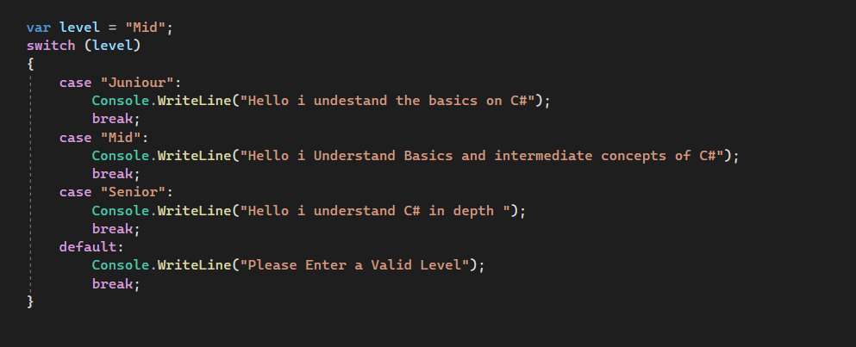

Slide 10

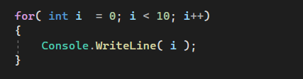
Loops in C#
Loops is the process of repeatedly executing a statement or group of statements until the condition is satisfied. When the condition becomes false the execution of the loop terminates.
The Whole intention of loops in programming is to make the code cleaner and efficient as well as make the developer job easier e.g. if you were to print numbers from 0 to 9 without a loop you will have 10 console.write statements but with loops its one .

Slide 11
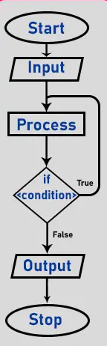
Types of Loops
For Loop
For each Loop
While loop
Do while loop

Slide 12

While Loops
A while loop is used for executing a statement repeatedly until a given condition returns false. Here, statements may be a single statement or a block of statements
While we are working with a while loop first, we need to check the condition, if the condition is true then the control will pass within the body and if the condition is false the control will pass outside the body.
While we are working with a while loop first, we need to check the condition, if the condition is true then the control will pass within the body and if the condition is false the control will pass outside the body.

Slide 13
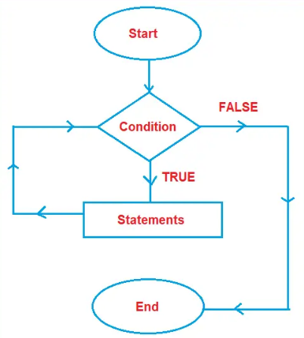

Slide 14
